Slide 1
Rockingham Incremental Development Working
Group (RIDWG)

Slide 2
Challenges and Opportunities
CHALLENGES - DIRECTION
Administrative Hurtles
Zoning – Town Plan Update – resistance to change?
No Housing in many downtown 2nd & 3rd floor spaces.
OPPORTUNITY - HOUSING SOLUTIONS
Education of Decision Makers – TriBoard
Bylaw Modernization - HOME Act - Allow for density - Align zoning
Develop ADU’s (carriage houses)
Optimize what already exists through smart division of larger properties (apartments or condo).
Rental Rehab PreserveIn
Fill VT Homes For All
5. Area Wide Plan – Mixed Use

Slide 3
Incremental Development Alliance

Slide 4
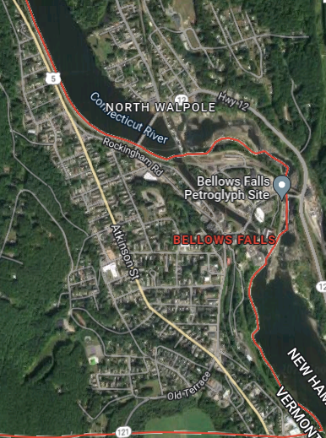
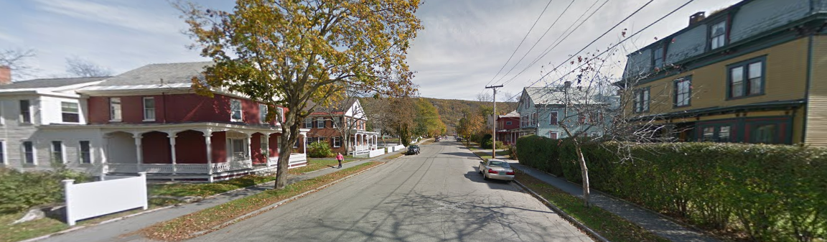
Bellows Falls Character
R-7 Zoning District
  46% non-conforming lots = 7,000 sq. ft minimum
  1-⅓ mi long x ⅓ mi wide
  2nd largest by area
  Covers 30% of total Village area
  Contains 686 lots
Notes:
R7 District

Slide 5
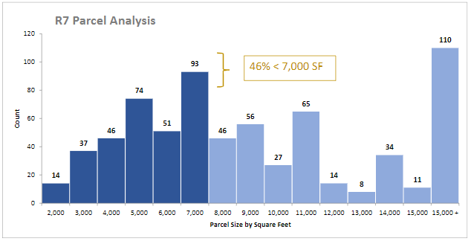
Small lot sizes
315
371
25% < 5,000 SF
38% 8,000-15,000 SF
Source: Inc Dev Alliance: Bellows Falls Clinic and Diagnostic -Small Group Summary & Next Steps
Notes:
R7 District: 686 small lots,, 25% less than 5000SF, 38% are medium sized lots between 8.000 and 15,000SF

Slide 6
VHFA - Data
H

Slide 7
Partnering with Windham & Windsor Housing Trust – Rockingham Rental Rehab Grant Program
Town of Rockingham - USDA Housing Preservation Grant
- $50,000 Housing Repair Fund into Town Revolving Loan Fund Housing Policy
- Repair and rehabilitation of housing owned or occupied by low and very low-income rural citizens
- USDA requires grantee to choose single family or 2 to 4
family homes
TOR matched W-WHT RRR up to $10,000, with $5,000 loan and $5,000 Grant
  3 Houses- $10,000 each
  6 units altogether some brought back on-line and others retained habitability

Slide 8
Homes For All – InFill Toolkit
Existing Conditions
Municipal Water and Sewer
Developable Area fit 1–4-unit New Infill
Predesigned Building Templates to fit on Parcel
Meets code, Zoning
Materials available, cost effective, efficient
Homes for All Toolkit complete
Final piece - financial

Slide 9
Area Wide Plan: Mixed-Use Housing opportunities

Slide 10
Thank you!
Contact:
Gary Fox: development@rockbf.org
802.376.5425
Town of Rockingham Housing Revolving Loan Fund: Policy, Procedures and Application
Windham & Windsor Trust Rental Rehab: https://www.homemattershere.org/rental-rehab/
VT Homes for All: https://accd.vermont.gov/homesforall
Photo: Wunderbar

